Slide 1
EmergingLeadersAlliance.org

Slide 2
The ELA began as a joint effort of the engineering Founder Societies that was started in 2008 and has remained a collaborative effort.
UEF
Founder
Societies
Other organizations currently in the alliance:
Two United Engineering Foundation (UEF) Founder Societies are
in the Alliance.
Other
Partnering
Societies
ELA
All four AIME Member Societies
are in the Alliance.
AIME
Member
Societies
2

Slide 3
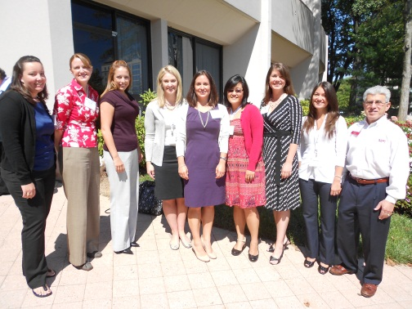
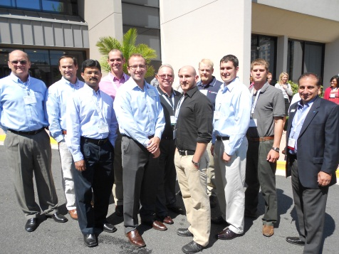
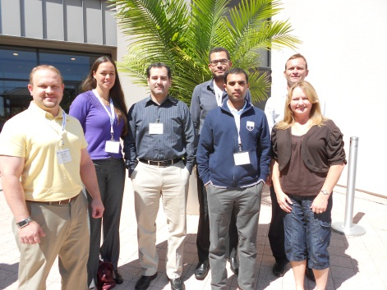
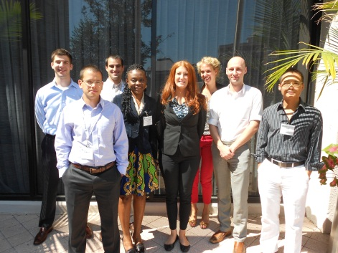
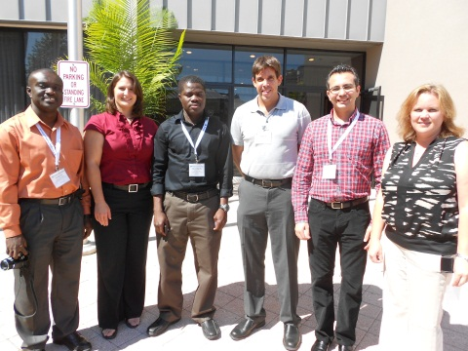
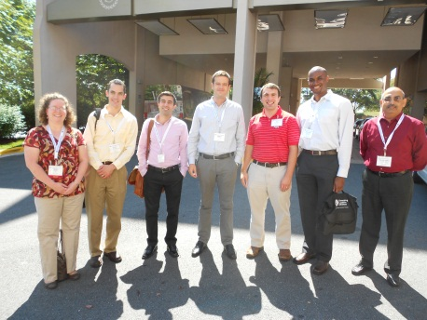
The project has been supported in 2008-2011, and 2013 by the United Engineering Foundation.
3
Notes:
Promote purpose and sponsors

Slide 4
The Need
NAE’s The Engineer of 2020 report:
Who are the engineering and scientific leaders of the 21st century? They will be engineers and scientists reflecting the evolution of our professions. They will have a wide range of complementary, nontechnical skills.
Society will need them to address “real problems facing mankind,” including energy, sustainability and healthcare.
NSF’s “Future of Materials Science and Engineering Education” workshop summary promoted introducing “soft” skills (e.g. presentation, business, ethics) by integrating them with technical learning and maintaining balance
The ELA program benefits engineering individuals, corporations that employee them, and the professional societies to which they belong:
Accelerates emerging leaders in their careers
Trains future leaders, mentors of organizations
Enhances organizational image and supports a core societal role of education
We know of no other comparative U.S. program that provides the opportunity to interact across disciplines and obtain foundational executive-level skills for such an exceptional value and seeks industry support through sponsorships and leadership involvement in the program.
4

Slide 5
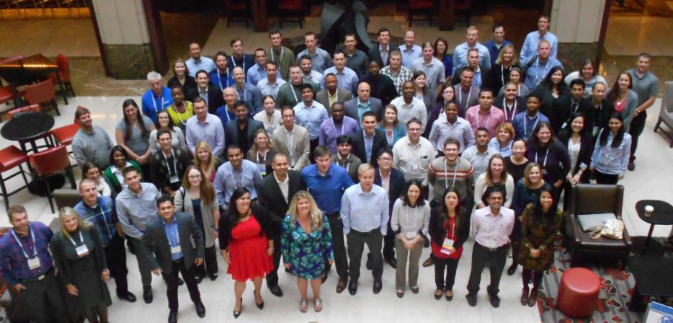
The Vision
The Emerging Leaders Alliance will be a respected provider of
cost-effective, efficient, high-quality leadership training and networking for emerging leaders in the engineering and scientific community.
5

Slide 6
Feedback from Conference Attendees . . . .
How satisfied were you with the value of the sessions, in relation to your development as a leader?
6

Slide 7
Feedback from Conference Attendees . . . .
73% of 2021 conference attendees rated the event as Excellent!
I made a presentation on ELA to colleagues in the office, I could feel their envy.
ELA Rocks!!
ELA was the most interactive and most hands on conference/workshop/forum I have ever had in my life. The instructors were amazingly practical. Exactly as I hoped. The Social Styles session was the best instruction I have ever had . . .
The ELA participants were equally amazing. Very well selected from their societies.
I thought the conference was excellent. I enjoyed meeting different type of engineers, switching tables each day, the interactive aspects of the speakers, and the amount of time for each session. I've already told multiple friends of mine to apply for next year.
I found that this conference was very timely for my career and that many other participants were facing the same challenges as me in our respective careers.
Thank you for organizing such a great conference. It was very valuable and inspiring for me. I already started applying some of the key strategies I have learned during the conference. I am very grateful for the opportunity to be a part of it.
7

Slide 8
The 2024 ELA Conference
High quality training, planned by professional societies, delivered efficiently at an exceptional value, for select emerging leaders within the engineering and scientific community!
Training Includes:
Pre-conference Social Styles Survey
Annual Leadership Training Conference
(22-25 September 2024 in Pittsburgh, Pa.)
Online ELA Resource Library
8

Slide 9
Partner Requirements
Partnership fee of $6,500.
A staff representative to participate on the Program Committee and help out at the live conference.
Recruit 7 participants from your organization to attend the conference with your staff liaison.
Help to solicit sponsorships and new partners.
9

Slide 10
Partner Benefits
Participation in program content development and future direction
Cross-disciplinary networking for your members
Marketing support
Recognition in all ELA marketing materials, including the ELA website and conference program
Active participation in a collaboration that serves the greater engineering community!

Slide 11
For more information, visit
EmergingLeadersAlliance.org
Or Contact
Chris McKelvey, AIST
cmckelvey@aist.org
+1.724.814.3076
11

